Slide 1
K-Nearest Neighbor Learning

Slide 2
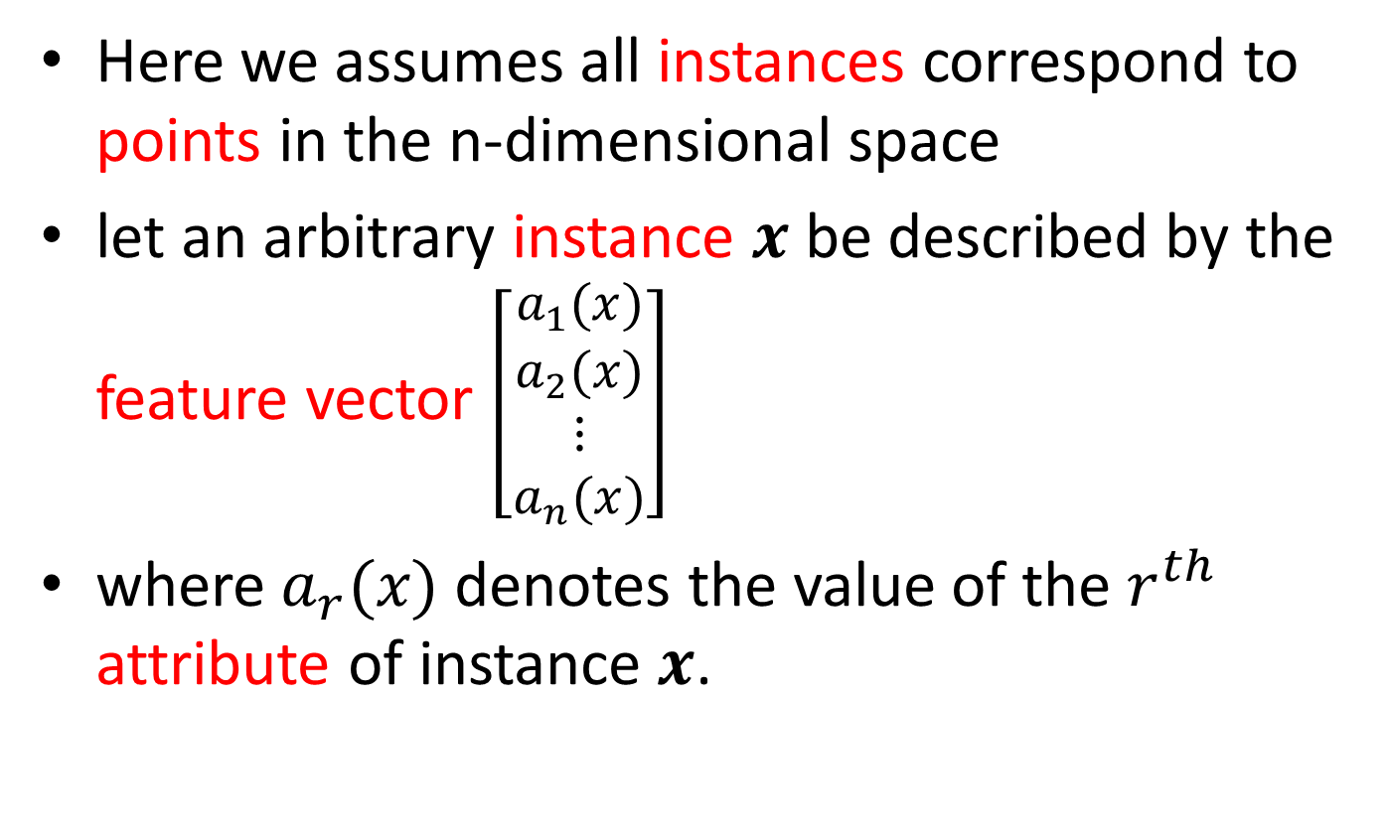
K-Nearest Neighbor
Here we assumes all instances correspond to points in the n-dimensional space
let an arbitrary instance $x$ be described by the feature vector $\left[\begin{matrix}a_{1}(x) \\ a_{2}(x) \\ \begin{matrix}⋮ \\ a_{n}(x)\end{matrix}\end{matrix}\right]$
where $a_{r}(x)$denotes the value of the $r^{th}$ attribute of instance $x$.

Slide 3
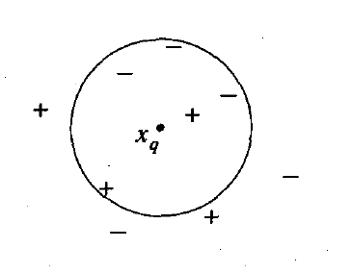
Classification
The class of an unknown instance (test instance) is predicted using the classes of its nearest training instances in the space by majority voting.

Slide 4
Distance Measure
We need to measure distance between 2 instances
Hamming Distance
Euclidean Distance
Cosine Similarity

Slide 5
Text Classification
The goal is to identify the topic (the class) for a piece of text (document)
Now lets use KNN for Text Classification
Here each document is an instance

Slide 6
A Simplified Example
Topic
Training Documents:
D1:
Life
We have a purpose
D2:
Death
We will die
Test Documents
D3:
???
A real purpose
Here each word is a feature
We represent each document as a vector
Body

Slide 7
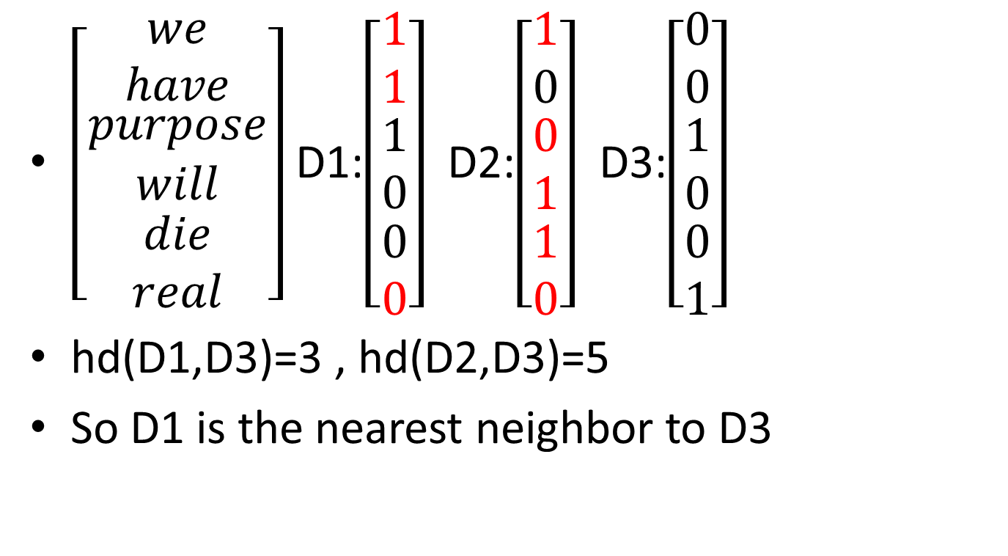
Hamming Distance
$\left[\begin{matrix}we \\ have \\ \begin{matrix}purpose \\ will \\ \begin{matrix}die \\ real\end{matrix}\end{matrix}\end{matrix}\right]$ D1:$\left[\begin{matrix}1 \\ 1 \\ \begin{matrix}1 \\ 0 \\ \begin{matrix}0 \\ 0\end{matrix}\end{matrix}\end{matrix}\right]$ D2:$\left[\begin{matrix}1 \\ 0 \\ \begin{matrix}0 \\ 1 \\ \begin{matrix}1 \\ 0\end{matrix}\end{matrix}\end{matrix}\right]$ D3:$\left[\begin{matrix}0 \\ 0 \\ \begin{matrix}1 \\ 0 \\ \begin{matrix}0 \\ 1\end{matrix}\end{matrix}\end{matrix}\right]$
hd(D1,D3)=3 , hd(D2,D3)=5
So D1 is the nearest neighbor to D3

Slide 8
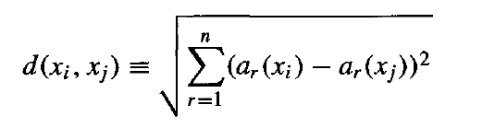

Euclidean Distance
Put word frequencies of the document in the corresponding cell
Then the Euclidean distance between two instances $x_{i}$ and $x_{j}$

Slide 9
Cosine similarity with TF-IDF weights
now each number is the TF-IDF weight for the corresponding word
Let w be a word, d be a document, N(d,w) be the number of occurrences of w in d
TF(d,w) = N(d,w) / W(d), where W(d) is the total number of words in d
IDF(d,w) = log( D / C(w) ), where D is the total number of documents(train+test), and C(w) is the total number of documents that contains the word w
The TF-IDF weight for w in d is TF(d,w)*IDF(d,w)

Slide 10
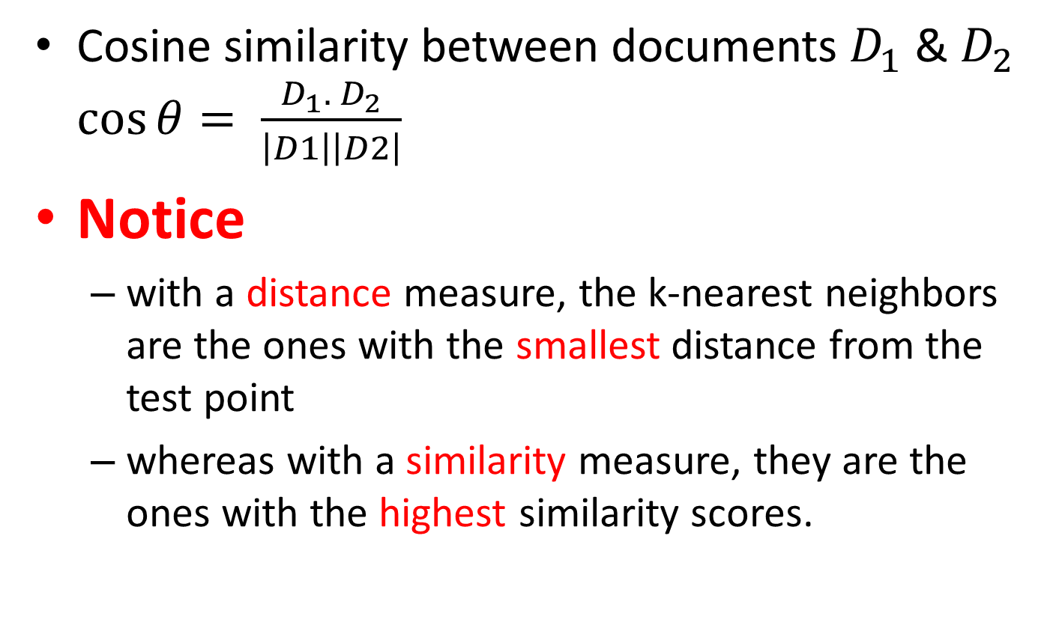
Cosine similarity
Cosine similarity between documents $D_{1}$ & $D_{2}$ $\cos{θ}= \frac{D_{1}. { D}_{2}}{\left|D1\right|\left|D2\right|}$
Notice
with a distance measure, the k-nearest neighbors are the ones with the smallest distance from the test point
whereas with a similarity measure, they are the ones with the highest similarity scores.

Slide 11
Try k = 1, k = 3 and k = 5 with each of the Distance measure

